Slide 1
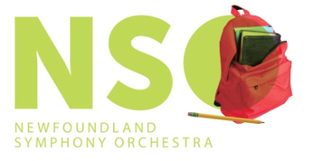
Edvard Grieg and Jean Sibelius
Symphony Goes to School...and Beyond! Program
NSO Education Program
Prepared by Timothy Brennan
Copyright © NSO 20

Slide 2
This presentation explores the life and music of two famous Scanadanvian composers: Edvard Grieg and Jean Sibelius

Slide 3
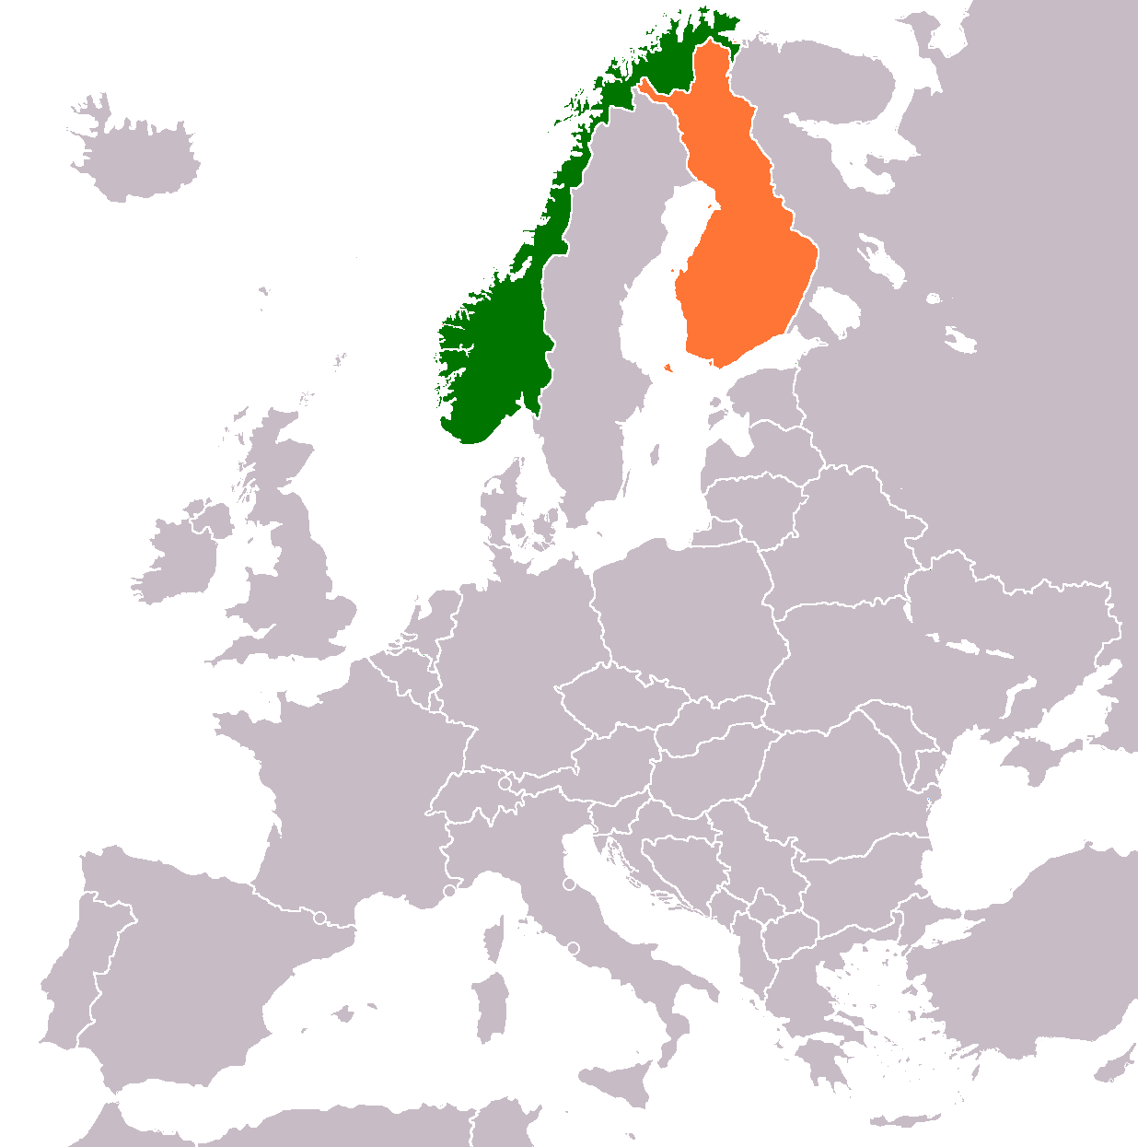
Where in the World?
Scandinavia is a region in northern Europe that includes the countries of Denmark, Norway, Sweden, and Finland.
Grieg was from Norway (green) and Sibelius was from Finland (orange).
Norway
Finland

Slide 4
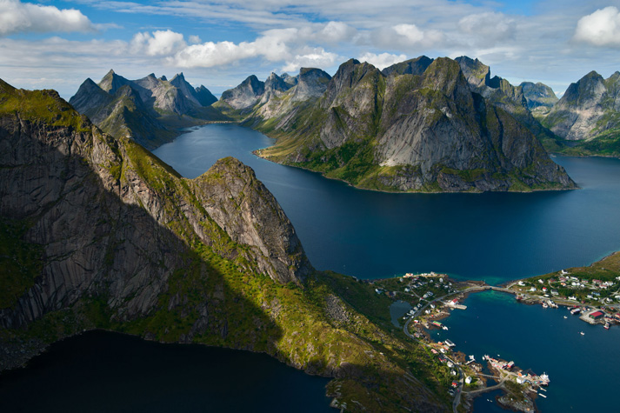
Fast Facts: Norway
Capital: Oslo
Famous for stunning fjords and natural landscapes.
Unique cultural aspects include:
Hardingfele - a traditional bowed string instrument
Lefse - a potato flatbread topped with butter and sugar (served at Christmas)
Well-known Norwegians include Edvard Munch (painter of The Scream) and Sissel Kyrkjebø (singer).
Fjords in Norway’s Loften Islands

Slide 5
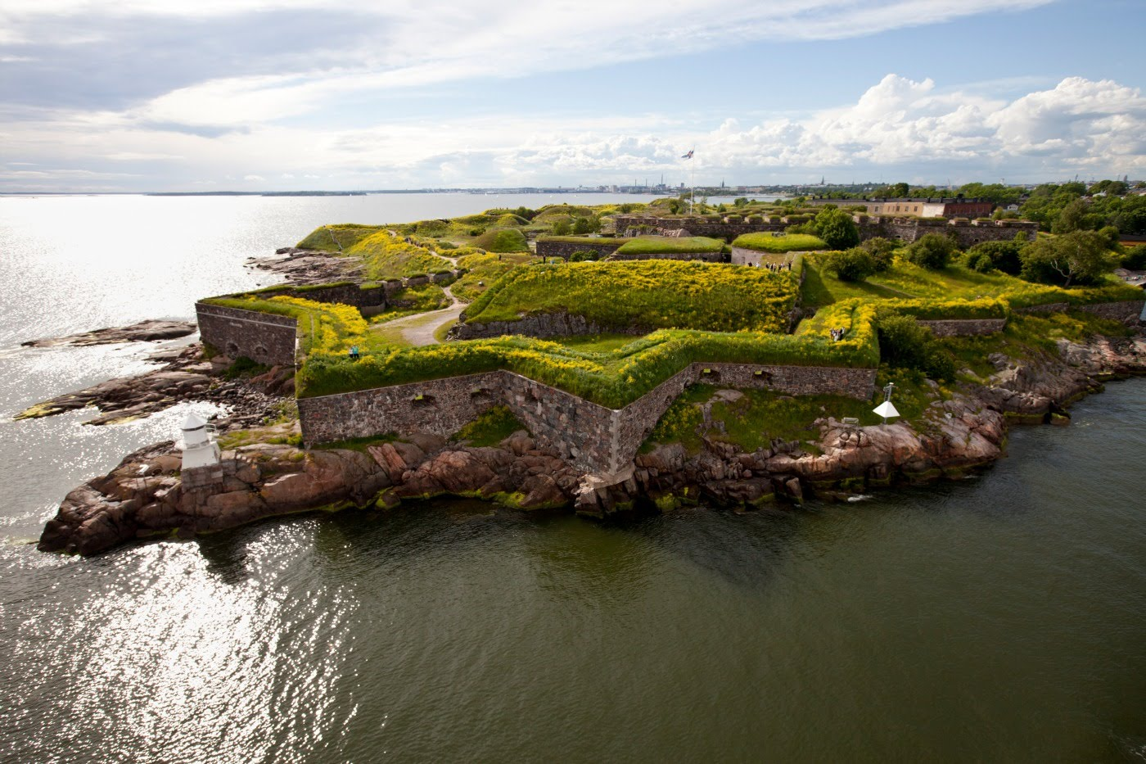
Fast Facts: Finland
Capital: Helsinki
Once belonging to Tsarist Russia, Finland gained independence on January 4, 1918.
Finland has won the most gold medals per capita in the Olympic Games compared to any other country.
Famous Finns include: Esa-Pekka Salonen (conductor of the Los Angeles Philharmonic), Rajaton (a capella singing group), and Magnus Lindberg (composer).
One of Finland’s most popular tourist attractions and a UNESCO World Heritage site, Suomenlinna is an inhabited 18th century sea fortress that forms a part of capital city Helsinki.

Slide 6
Grieg and Sibelius: Musical Eras
Grieg lived and composed primarily during the Romantic era.
Sibelius overlaps the Romantic era and the Modern era (20th century).

Slide 7
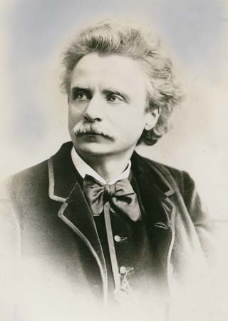
Fast Facts: Edvard Grieg
Born in Bergen, Norway in 1843.
At age 15, he began studying piano and composition at the Leipzig Conservatory in Germany.
Grieg made his professional concert debut in 1861 in Karlshamm, Sweden.
He was Music Director of the Bergen Philharmonic Orchestra from 1880-1882.
Grieg died of heart failure in the summer of 1907 (age 64).

Slide 8
Grieg’s Notable Compositions
Many of Grieg’s compositions highlight Norwegian folk traditions and folk songs/tales. The following works are representative of his high-Romantic, yet distinctly Norwegian style.
Click on the links below to hear these pieces:
“Morning Mood” from Peer Gynt Suite No. 1 Click here
“In the Hall of the Mountain King” from Peer Gynt Suite No. 1 Click here
“Wedding Day at Troldhaugen” from Lyric Pieces Book VIII, Op. 65 Click here
Sonata No. 3 for Violin and Piano in C minor, Op. 45 Click here

Slide 9
Grieg and Hollywood
Grieg’s compositions have been used in multiple soundtracks to feature films.
Recently, “In the Hall of the Mountain King” was used in the film The Social Network (2010) during a rowing race scene.
The gradual increase in tension and dynamic level in the music is well-suited to the high-stakes nature of a sports competition.
Click here to watch the scene.

Slide 10
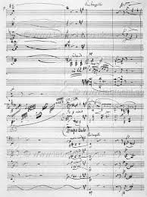
Composition Spotlight: Piano Concerto, Op. 16
One of Grieg’s most well-known compositions.
Composed in 1864 when he was only 24 years old.
Premiered in 1865 by pianist Edmund Neupert with the Royal Danish Orchestra.
Highly virtuosic and shows Norwegian folk influences, including references to the halling (a Norwegian dance) and the sound of the Hardingfele.
A page from the original autograph score of Grieg’s Piano Concerto in his own handwriting.

Slide 11
Composition Spotlight: Hear the Music
Click here to listen to a performance of Grieg’s Piano Concerto by Benjamin Grosvenor (a 25 year-old British concert pianist) with the Bergen Philharmonic Orchestra (the orchestra of which Grieg himself was Music Director from 1880-1882)!
After listening, answer the following question. There are no right or wrong answers, just answer based on your impression of the piece.
What aspects of the piano part of this concerto make this piece “flashy” or virtuosic? Refer to specific musical characteristics in your answer (e.g. rhythm, piano technique, etc.)

Slide 12
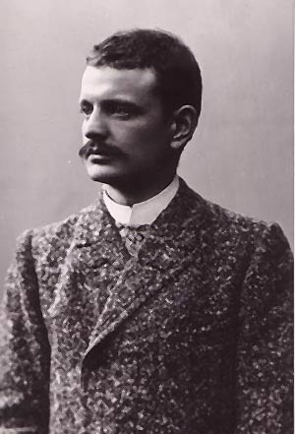
Fast Facts: Jean Sibelius
Born in Hämeenlinna, Finland in 1865.
After high school he studied law, but switched to music and studied violin and composition at the Helsinki Music Institute (later renamed the Sibelius Academy of Music in his honour).
Became well-known with the success of his First Symphony (1899) followed shortly by his tone poem Finlandia (1900)- see next slide.
He had six daughters with his wife Aino Sibelius.
Sibelius struggled with alcoholism and underwent surgery for throat cancer in 1907.
He died of a brain hemorrhage in 1957 at age 91.

Slide 13
Sibelius’s Notable Compositions
Like Grieg’s distinct Norwegian style, Sibelius’s music depicts a unique style characterized by Finnish nationalism and folk culture/traditions. The following works showcase Sibelius’s Finnish musical style.
Click the links below:
Finlandia, Op. 26 (orchestral tone poem) Click here
Karelia Suite, Op. 11 (orchestral tone poem) Click here
Kullervo, Op. 7 (programmatic choral symphony) Click here
Violin Concerto in D minor, Op. 47 Click here

Slide 14
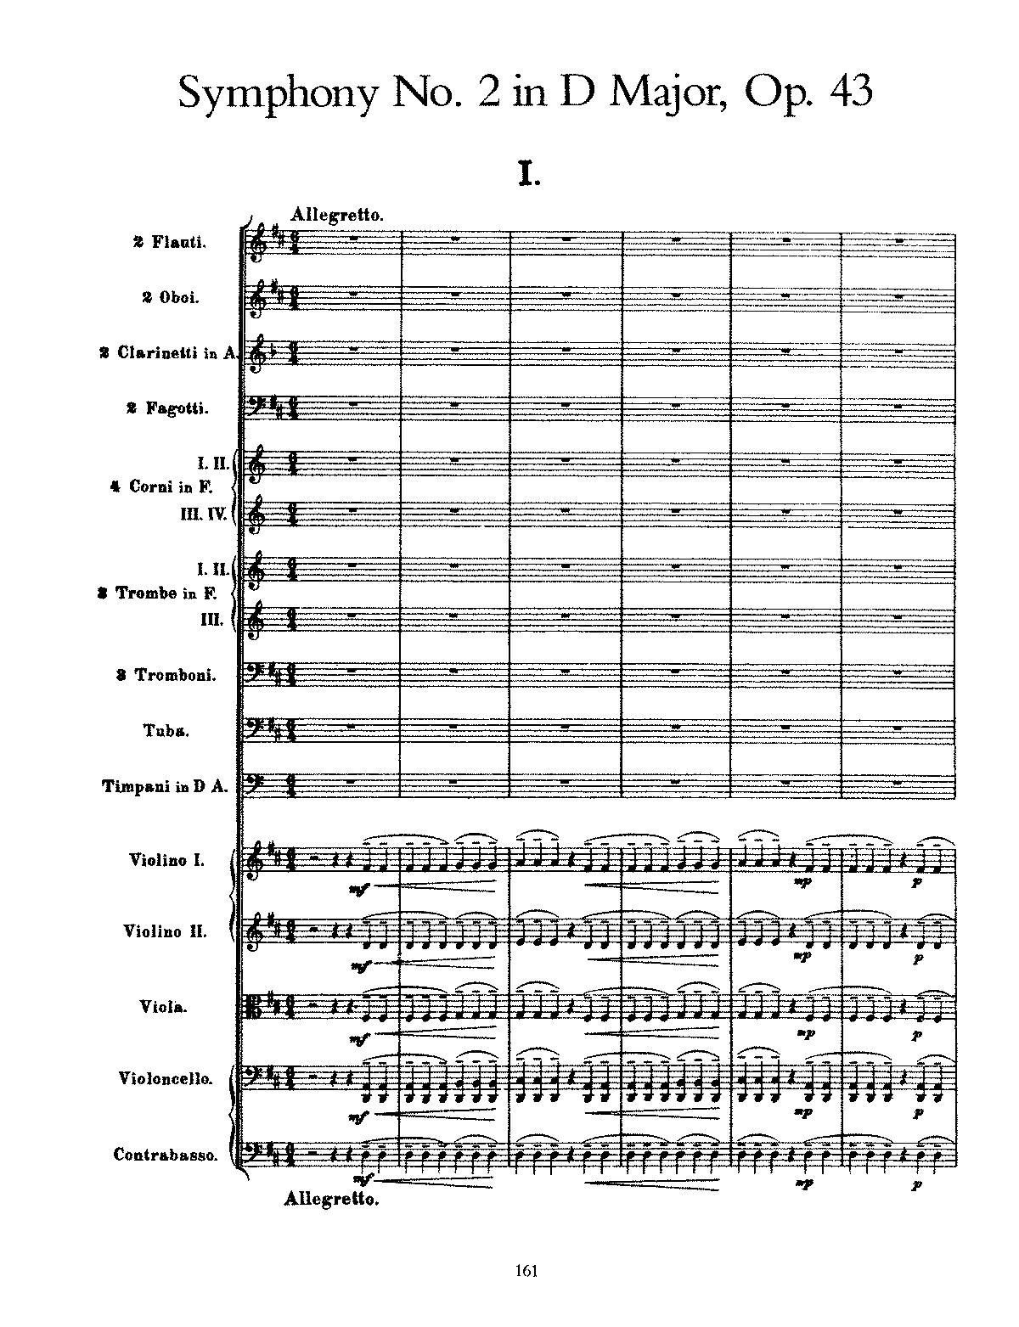
Composition Spotlight: Symphony No. 2, Op. 43
Composed from 1901-1902 while Sibelius was on retreat in Rapallo, Italy.
It was premiered by the Helsinki Philharmonic Society in 1902.
He described this symphony as “the confession of the soul.”
At the time of its premiere, it was widely regarded by the public as the “Symphony of Independence” due to its triumphant finale which, according to their interpretation, called the people of Finland to rise up against Russian rule.
Today, it is the most recorded symphony of Sibelius’s compositional output.
Opening of Sibelius’s Second Symphony

Slide 15
Composition Spotlight: Hear the Music
The Gustav Mahler Youth Orchestra (an orchestra comprised of school-aged children and based in Vienna, Austria) performs a selection from Sibelius’s Symphony No. 2 at the 2008 BBC Proms:
Click here to listen!

Slide 16
Exit Activity
Answer the following questions about this presentation:
Where did Grieg receive his musical education from age 15 onward?
What orchestra was Grieg music director of?
What Norewgian folk influences are present in Grieg’s Piano Concerto?
What compositions by Sibelius made him well-known?
What did Sibelius study before switching to music?
How did Sibelius describe his Second Symphony?

